Slide 1
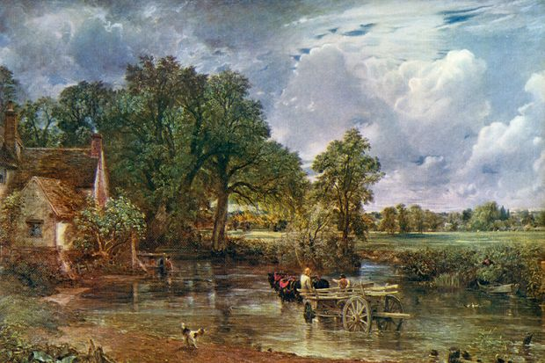
1. "The Hay Wain" [1821]?

Slide 2
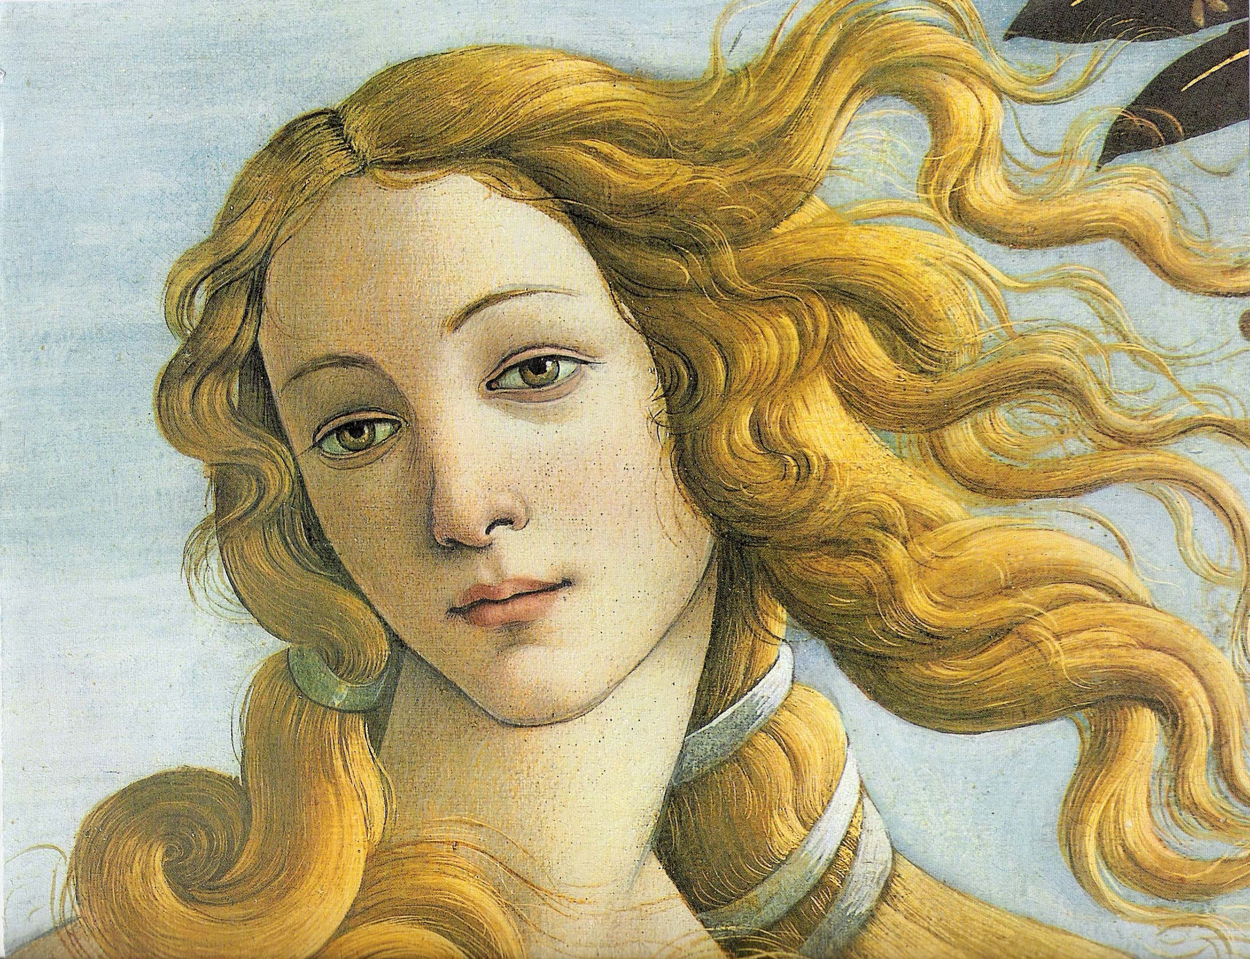
2. "Birth of Venus" [1482-6]?

Slide 3
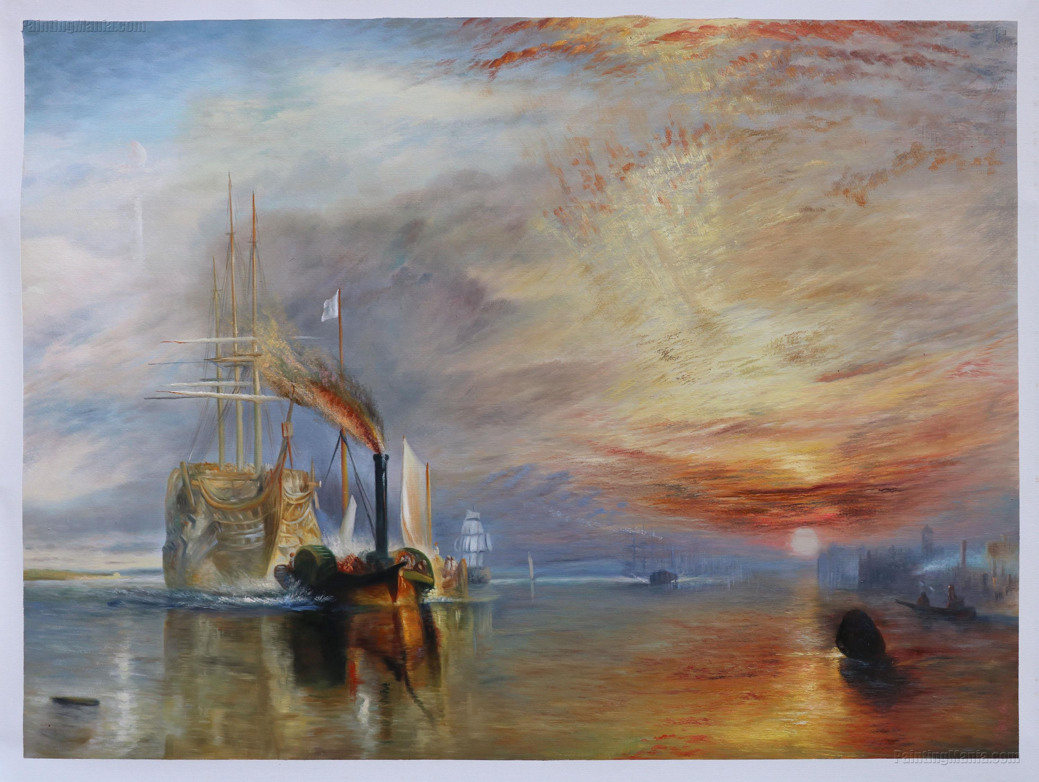
3. "The Fighting Temeraire" [1839]?

Slide 4

4. "Starry Night" [1889]?

Slide 5
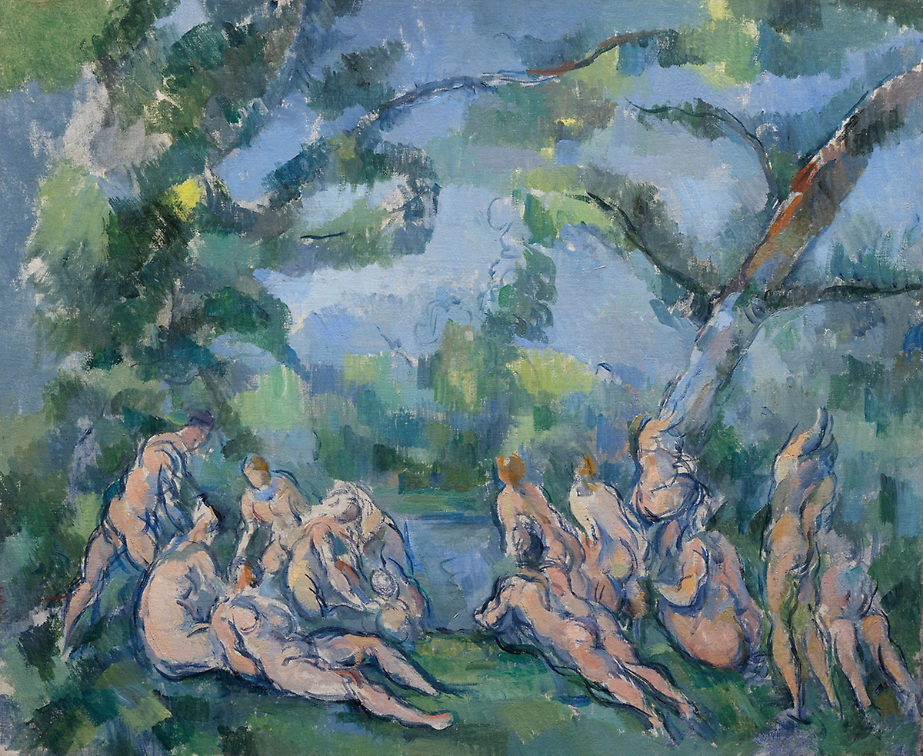
5. "The Bathers" [1905]?

Slide 6
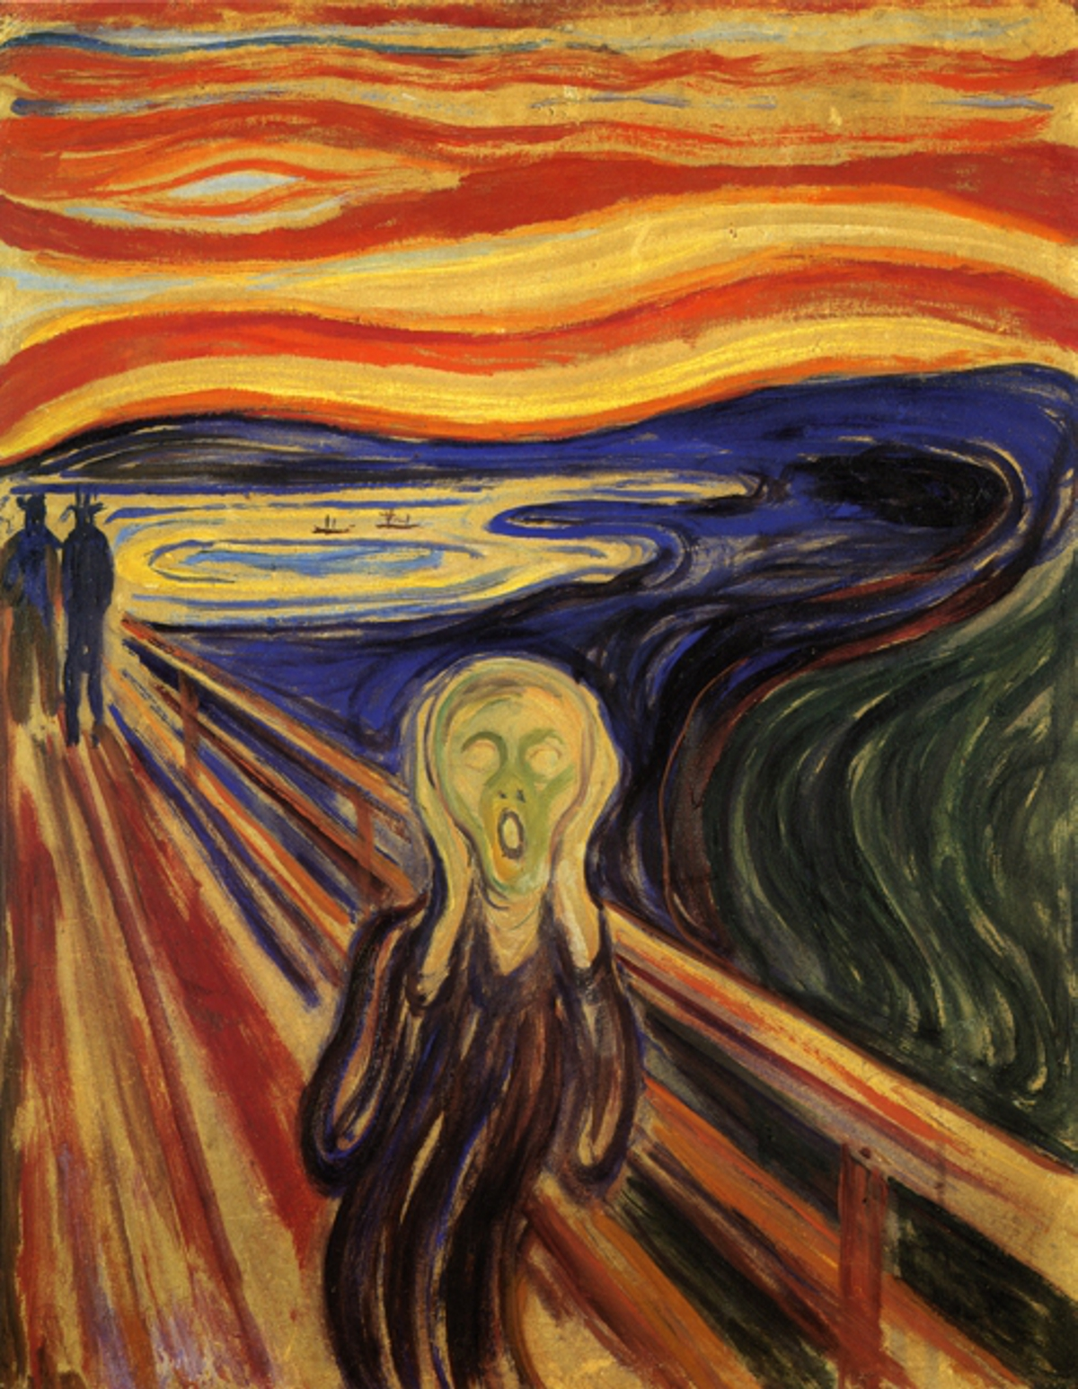
6. "The Scream" [1893]?

Slide 7
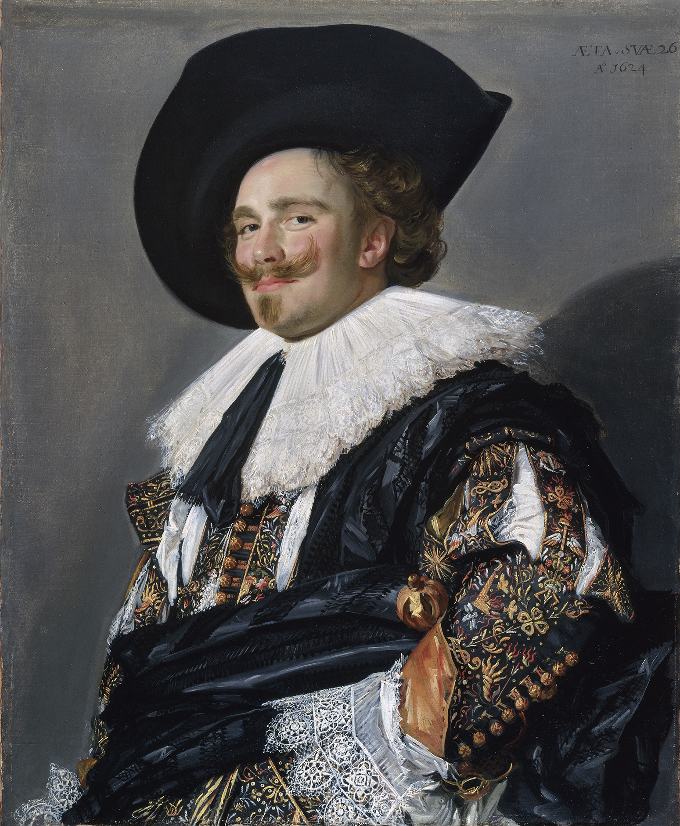
7. "The Laughing Cavalier" [1625]?

Slide 8
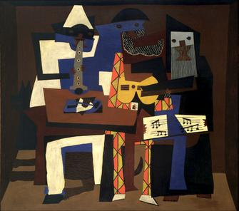
8. "Three Musicians" [1921]?

Slide 9
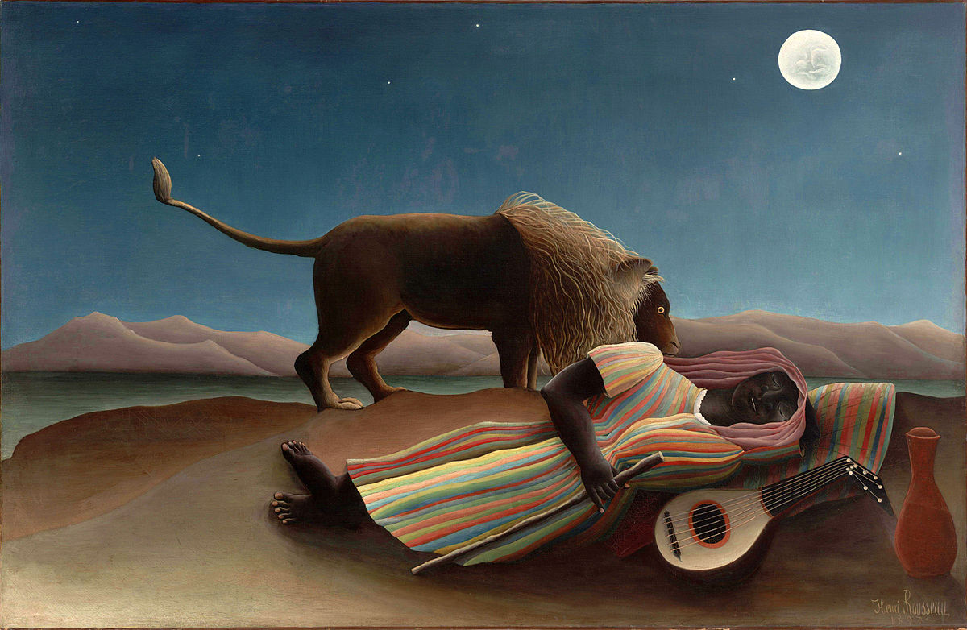
9. "Sleeping Gypsy" [1897]?

Slide 10
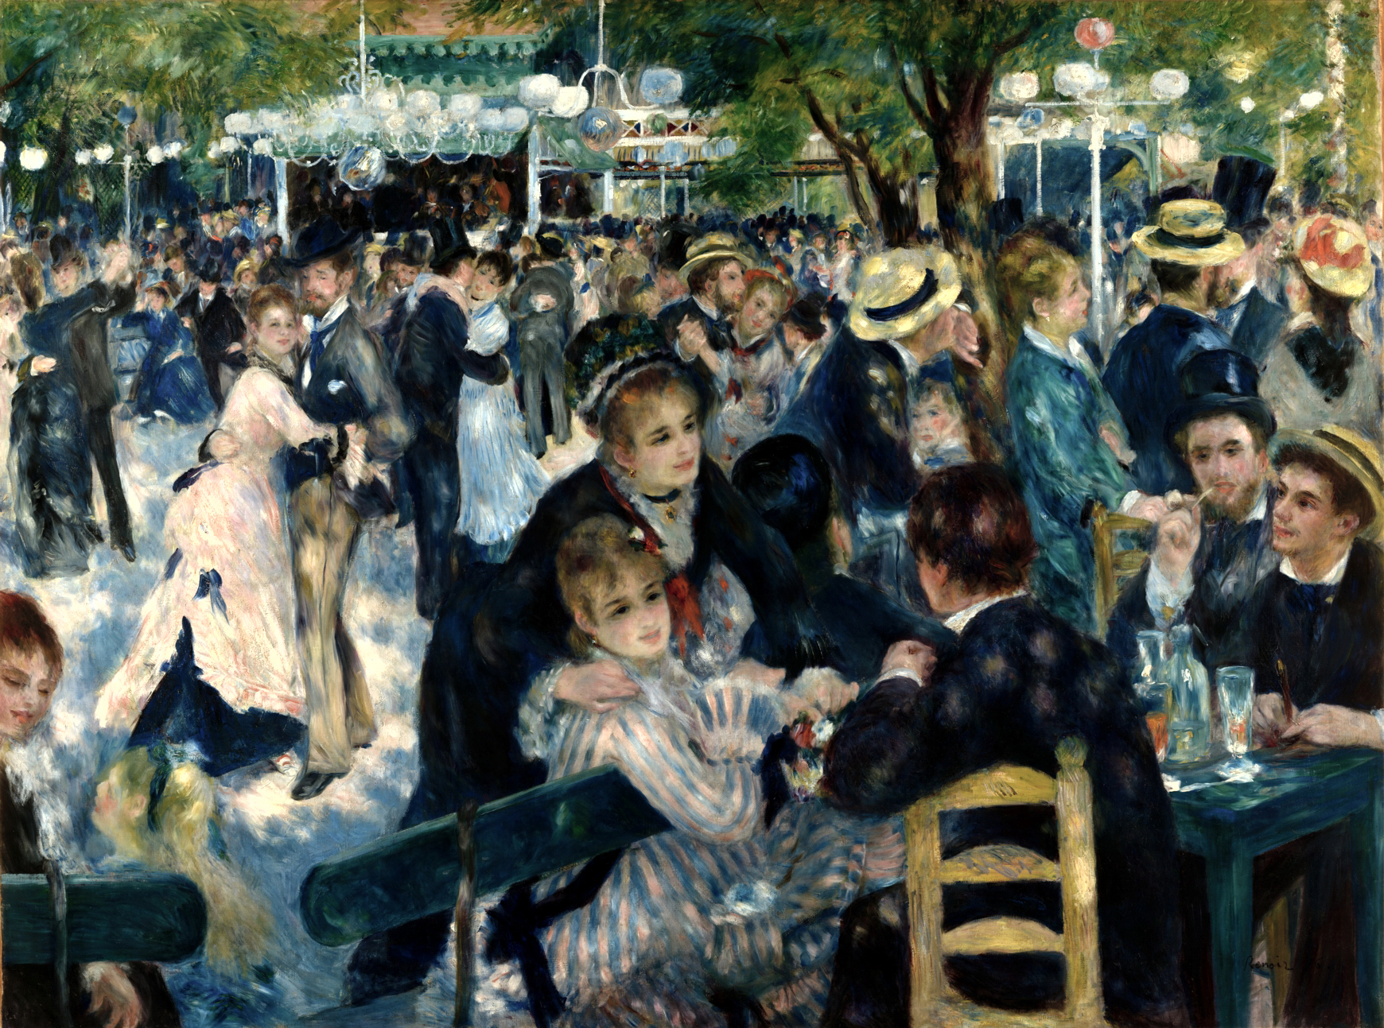
10. "Bal Du Moulin de la Gazette" [1876]?

